Slide 1
8255 PERIPHERAL INTERFACING

Slide 2
8255
Parallel I/O port chip
Programmable peripheral I/O port
General purpose programmable I/O device
Designed for use with 8-bit, 16-bit and higher capability µP
Designed to interface the CPU with its outside world such as ADC, DAC, keyboard etc

Slide 3
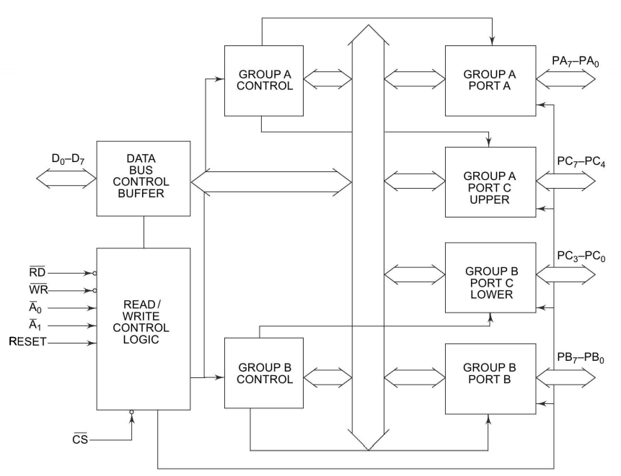
Internal Architecture

Slide 4
Internal Architecture
24 I/O pins
Individually programmed in to
Two groups of 12 lines each (Group A & Group B)
Three groups of 8 lines each
Group A contains
8-bit port (Port A) PA₇ – PA₀
4-bit port (Port c upper) PC₇ – PC₄
Group B
8-bit port (Port B) PB₇ – PB₀
4-bit port (Port c lower) PC₃ – PC₀

Slide 5
Internal Architecture
Port c upper and lower can be combined to function as 8-bit port
Three 8-bit I/O ports
Two 8-bit and two 4-bit I/O ports
All these ports can function independently either as input or output ports
Programming the bits of an internal register (control word register – CWR)

Slide 6
Internal Architecture
Three-state bi-directional 8-bit buffer is used to interface the 82C55 internal data bus with system data bus
Controlled by read/write control logic
Read/write control logic
Manages all of the internal and external transfer of both data and control words
Data is transmitted or received by the buffer upon execution of input or output instructions by the CPU

Slide 7
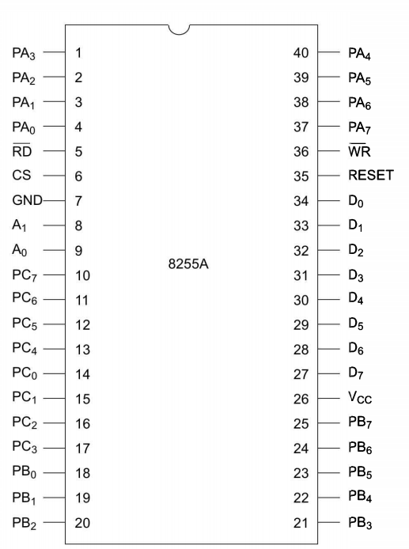
Signal Description
PA₇-PA₀
PB₇-PB₀
PC₇-PC₀
Act as either latched output or buffered input
Based on control word loaded into CWR
RD’
Low
Allows CPU to read from 8255
WR’
Low
Allows CPU to write data and control word in to 8255

Slide 8
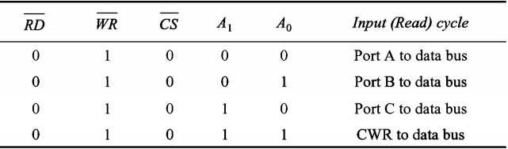
Signal Description (2)
CS’ (Chip select line)
Low – enable 8255 respond to RD’ and WR’ signal
A1- A0
Address input lines
Driven by the microprocessor
Used for addressing any one of four registers
Three I/O ports and one CWR

Slide 9
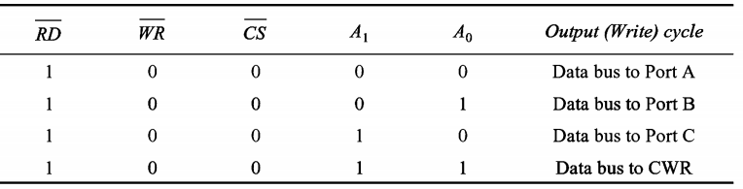
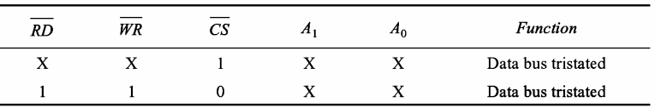
Signal Description (3)
D0-D7 (Data bus lines)
Carry data or control word to/from µP
RESET
High – Clears the control word register of 8255
Initialize CWR to 9Bh
All ports are set as input ports by default after reset

Slide 10
Modes of Operation
I/O mode
8255 work as programmable I/O ports
Bit Set-Reset (BSR) mode
Only port C can be used to set or reset its individual port bits
I/O mode
Mode 0 - Basic Input/Output
Mode 1 - Strobed Input/Output
Mode 2 - Bi-directional Bus

Slide 11
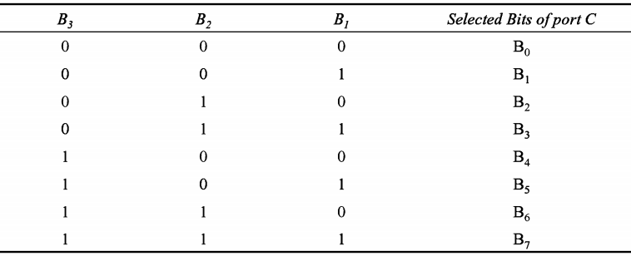
BSR Mode
Any of the 8-bits of port C can be set or reset depending on B₀ of control word
Bit to be set or reset is selected by bit select flags B3, B2 and B1 of the CWR

Slide 12
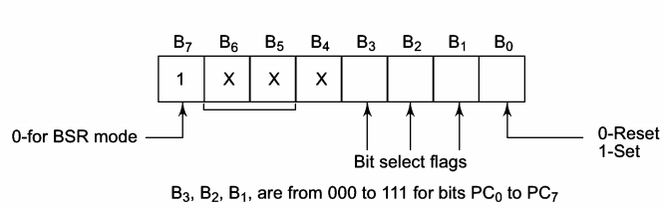
BSR Mode Control Word Register Format

Slide 13
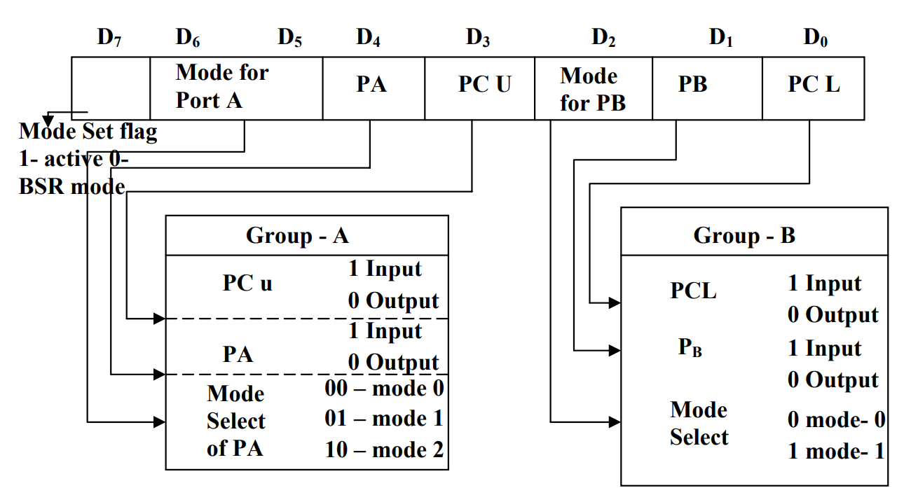
I/O Mode CWR Format

Slide 14
Mode 0
Basic input/output mode
Provides simple input and output capabilities using each of the three ports
Data can be simply read from and written to the input and output ports
1. Two 8-bit ports (port A and port B)and two 4-bit ports (port C upper and lower) are available
2. Any port can be used as an input or output port
3. Output ports are latched. Input ports are not latched
4. A maximum of four ports are available
Overall 16 I/O configuration are possible

Slide 15
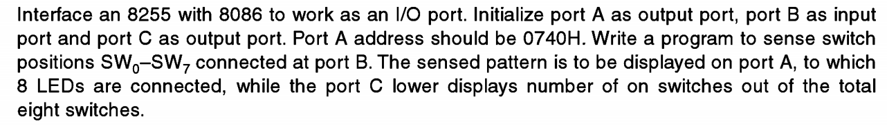
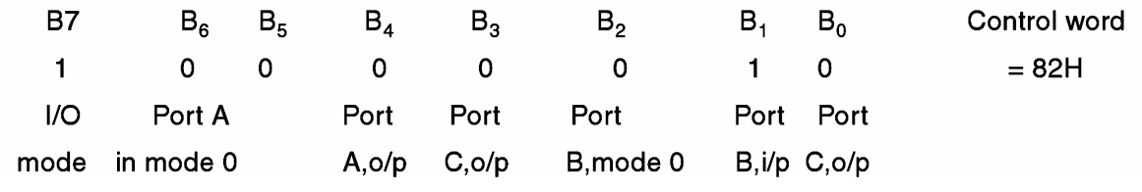
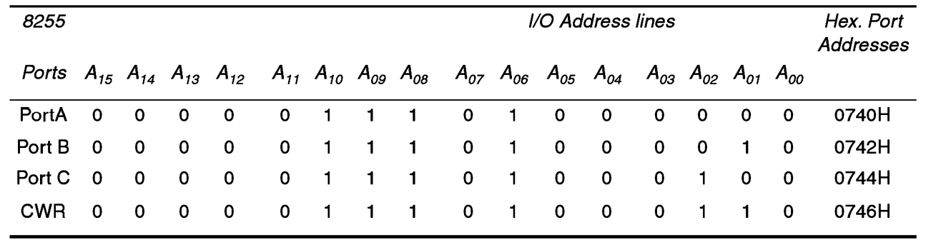
CWR
Port address

Slide 16
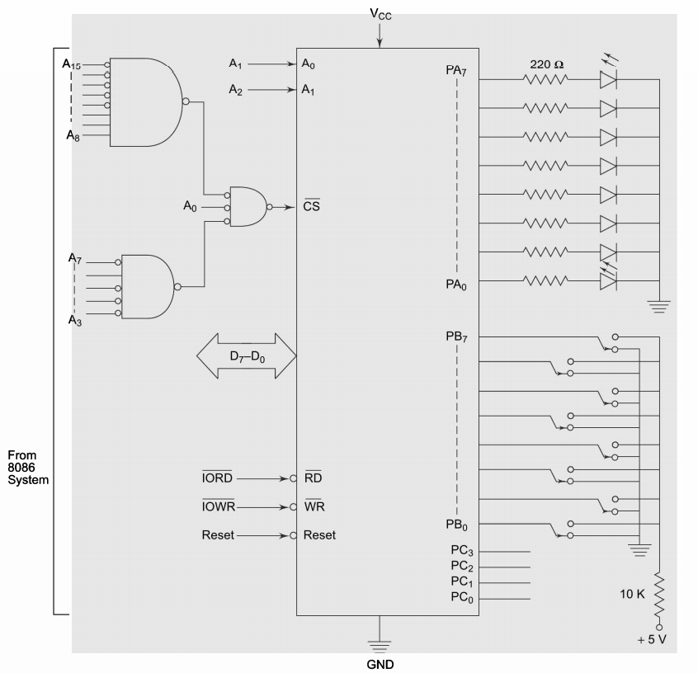
Interfacing
with 8086
IORD’ and IOWR’ readily available (8086 is in maximum mode)
Absolute decoding
All the 16 address lines for deriving the device address
A0 pin of 8086 is used for selecting the transfer on the lower byte of the data bus

Slide 17
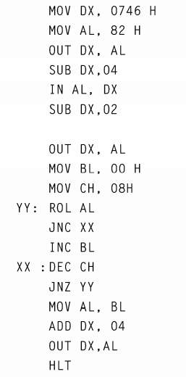
ALP
Get address of CWR in DX
Initialize CWR with 82H
Get address of port B in DX
Input port B value in to AL
Port B senses the switch position
Get address of port A in DX
Output AL value to port A
Initialize BL for switch count
Initialize CH for total number of switch

Slide 18
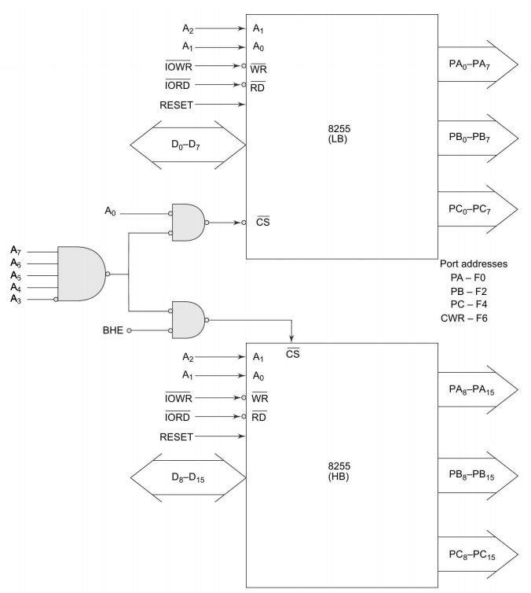
Interfacing 16-bit 8255 ports with 8086. Address of port A is F0H
Two 8255 are required
One will act as the lower 8-bit port D0-D7
Other will act as upper 8-bit port D8-D15
No absolute decoding scheme
Circuit is implemented using minimum hardware

Slide 19
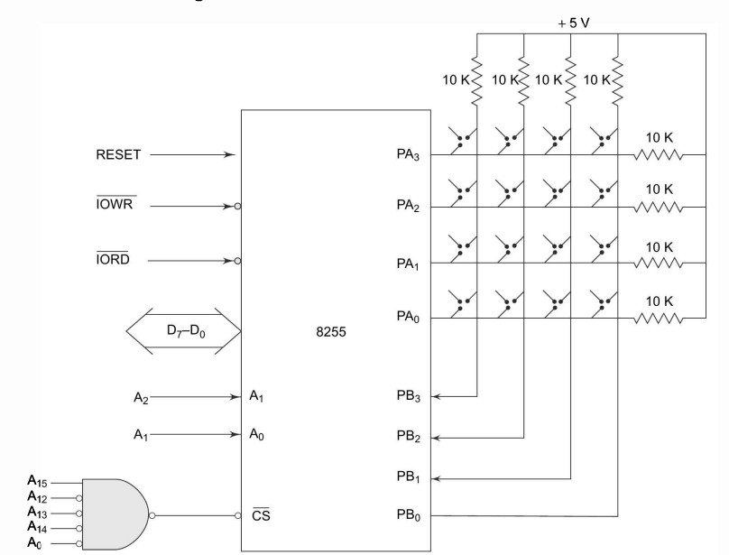

Slide 20
Matrix Keyboard Interfacing
Port address
Port A – 8000H
Port B – 8002H
CWR – 8006H
Control word (CW) – 82H
8255 interfaced with lower byte of 8086 data bus
Absolute decoding is not used to implement the circuit using minimum hardware

Slide 21
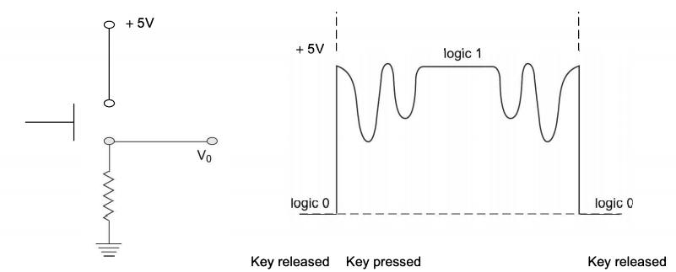
Key Debounce
Mechanical push button generate transient response whenever pressed/released
Microprocessor should wait for the transient period (10 ms)
Transient response settle down and reaches a steady state
8086 read logic zero when the key is pressed

Slide 22
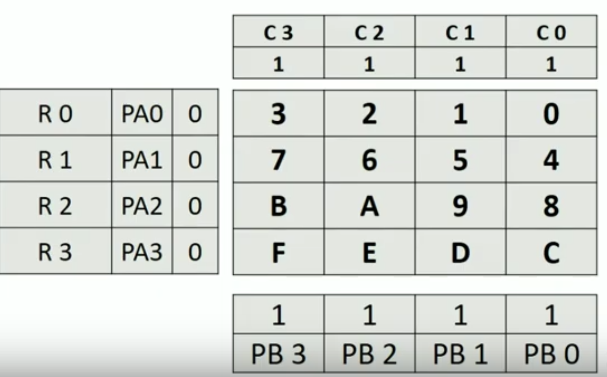
Identification of Key Pressed
Column identification
Row identification

Slide 23
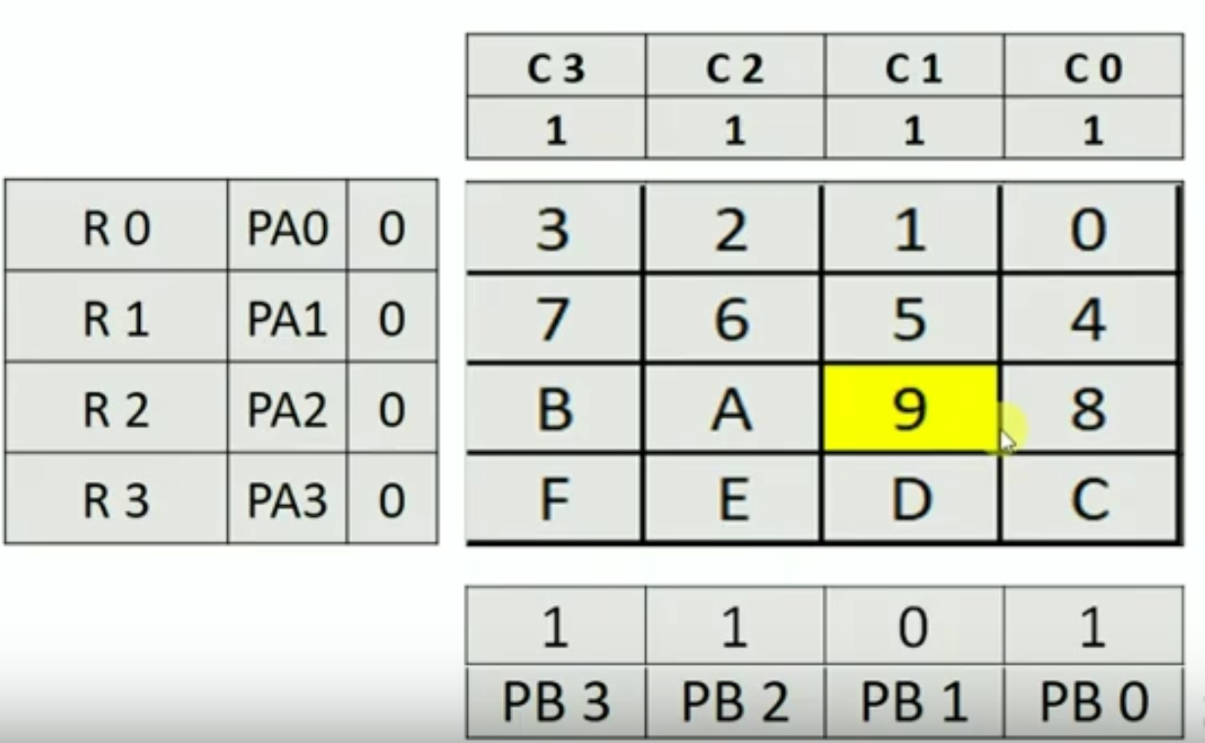
Column identification
Courtesy: OPENBOX Education

Slide 24
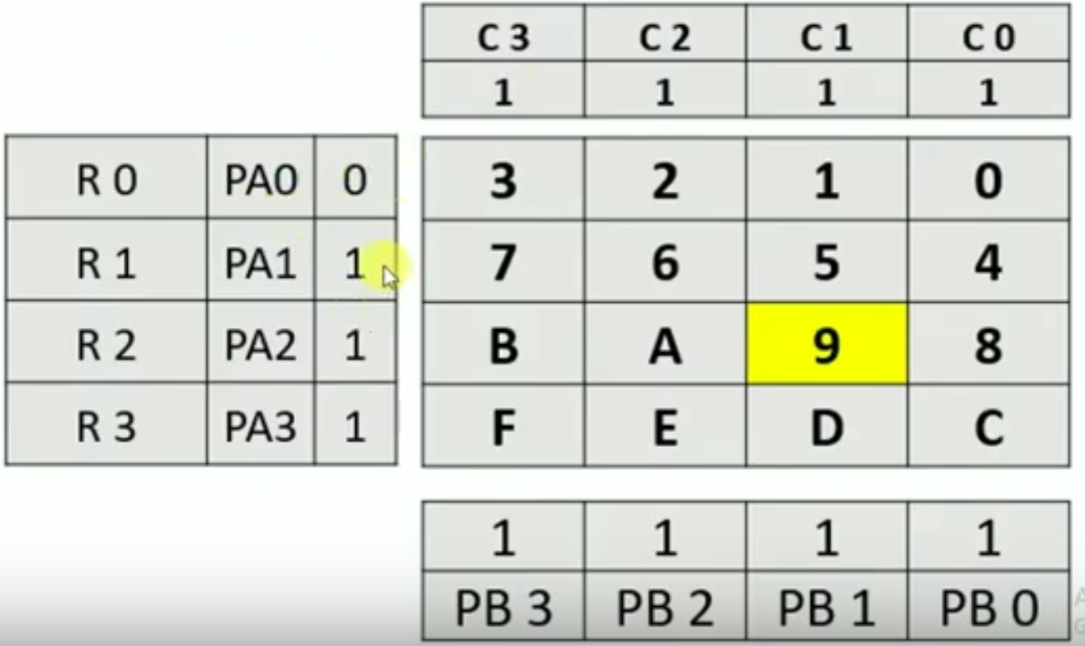
Row Identification
Courtesy: OPENBOX Education

Slide 25
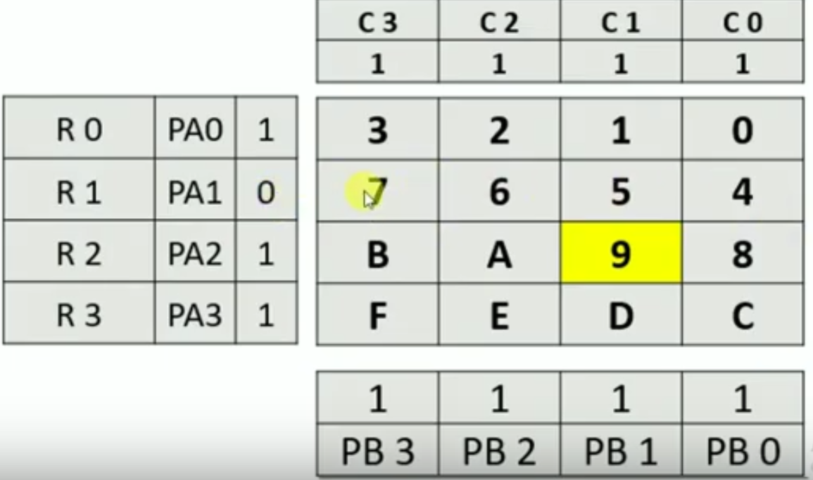
Courtesy: OPENBOX Education

Slide 26
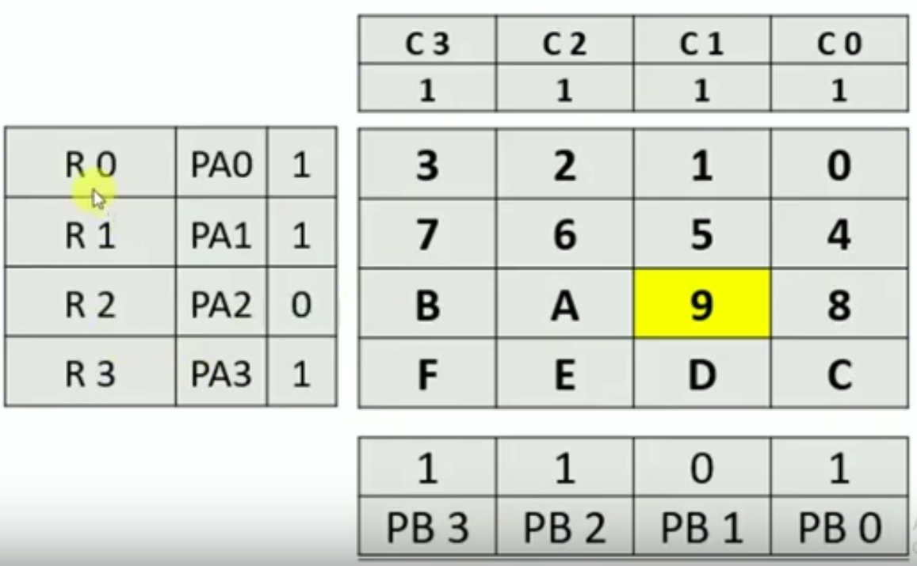
Courtesy: OPENBOX Education

Slide 27
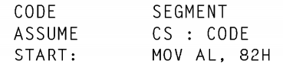
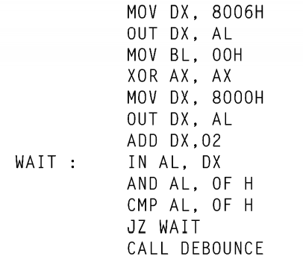
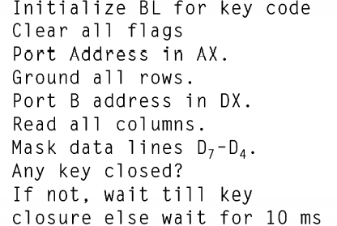
ALP for Matrix Keyboard Interfacing
Load CW in to CWR

Slide 28
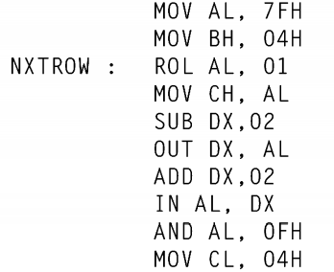
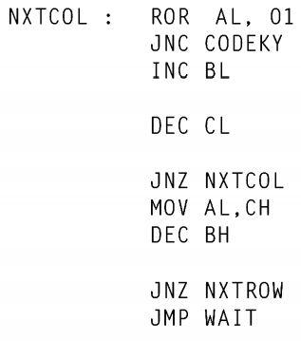
ALP for Matrix Keyboard Interfacing
Load data to ground a row
Set row counter
Rotate AL to ground next row
Save data to ground next row
Output port (port A) address is in DX
Ground one of the row Let A0
Input port (port B) address is in DX
Read input port for key closure
Mask upper nibble of AL
Set column counter

Slide 29
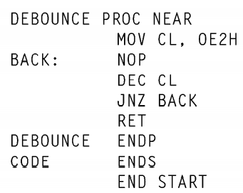
Procedure for Debouncing the Key

Slide 30
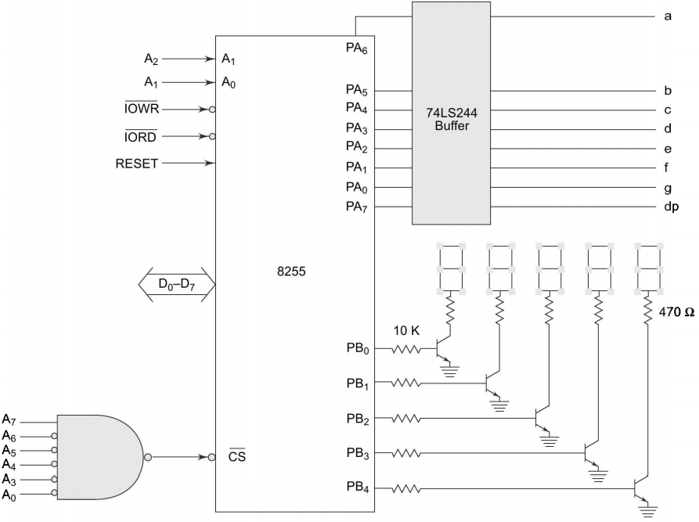

Slide 31
Mode 1 (Strobed I/O mode)
Handshaking signal control, input or output function of the specified port
Port C is used for generating handshake (control) signal
PC0-PC2 provide strobe or handshake lines for port B
PC3-PC5 provide strobe or handshake lines for port A
Group B - Port B and PC0-PC2
Group A - Port A and PC3-PC5
Both inputs and outputs are latched
PC6 and PC7 may be used as independent data lines

Slide 32
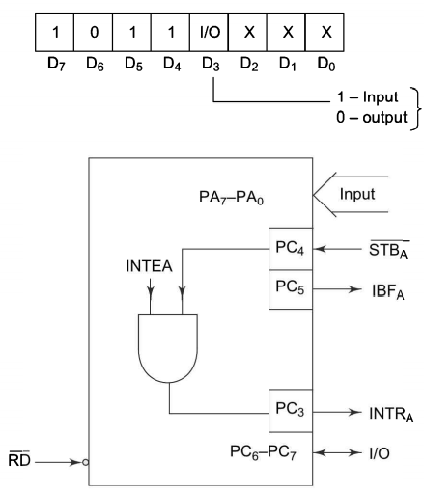
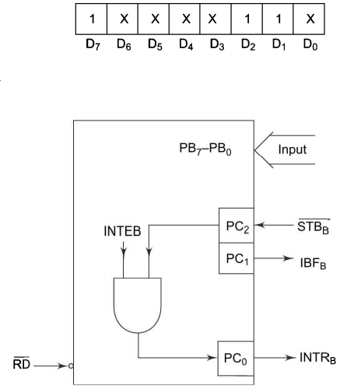

Mode 1 Control word Group Input A & B

Slide 33
Input Control Signal Definition in Mode 1
STB’ (Strobe Input)
LOW
Data available at 8-bit input port is loaded into input latches
IBF (Input Buffer Full)
Logic 1
Data has been loaded into the latches (acknowledgement)
Set by STB’
Reset by rising edge of RD’

Slide 34
Input Control Signal Definition in Mode 1
INTR (Interrupt Request)
Set by a high at STB’ and high at IBF pin
Reset by a falling edge on RD’ input
INTE (Internal flag)
Controlled by BSR mode of PC4 (INTE_{A}) or PC2 (INTE_{B})
External input device can request the service of the processor by putting the data on the bus and sending the strobe signal

Slide 35
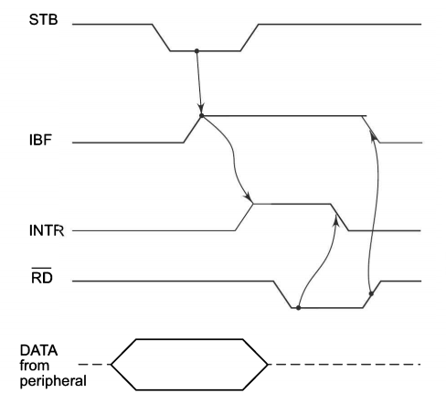
Mode 1 Strobed Input Data Transfer

Slide 36
Output Control Signal Definition in Mode 1
OBF’ (output Buffer Full)
LOW
CPU written data to the specified output port
Set by a rising edge of WR’
Reset by falling edge at the ACK’ input
ACK’
LOW
Data transferred by CPU is received by the output device
INTR (Interrupt Request)
Set when ACK’, OBF’ and INTE are 1
Reset by falling edge on WR’

Slide 37
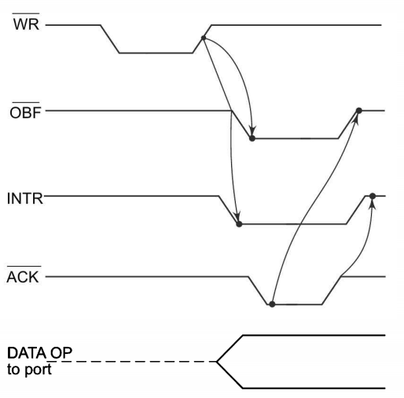
Mode 1 Strobed Output Data Transfer

Slide 38
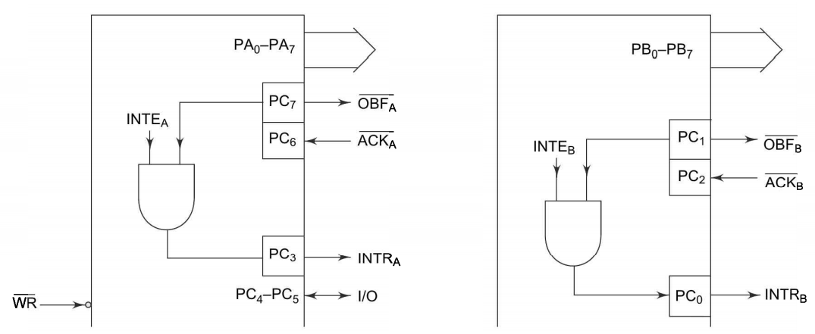
Mode 1 Control word Group Output A & B

Slide 39
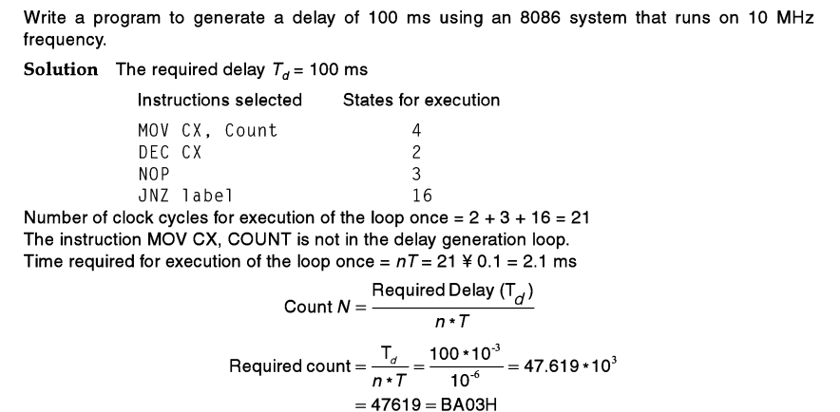

Slide 40
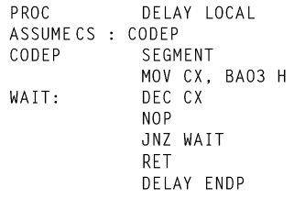

Slide 41
https://www.youtube.com/watch?v=Q1I4-8fVShA
A.K. Ray and K.M. Bhurchandi Advanced Microprocessors and Peripherals, third Edition, Tata McGraw Hill, 2012.

